Slide 1
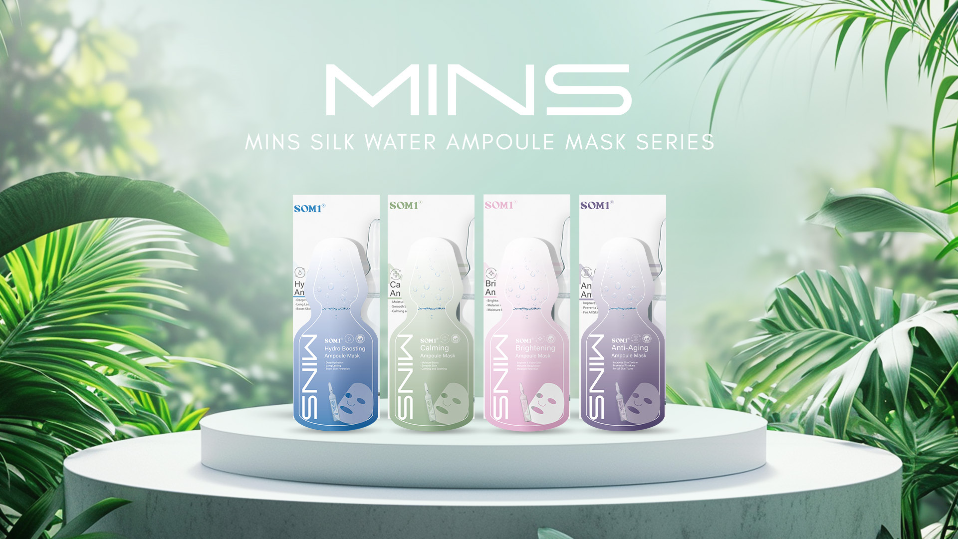

Slide 2
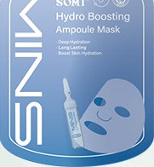
HYDRO BOOSTING
DEEP HYDRATING AMPOULE MASK
A deep hydrating ampoule mask can provide deep moisture, prolonged hydration, improve skin issues such as dryness and roug hness. It helps in increasing the moisture content of the skin, keeping it hydrated and smooth, resulting in a healthier appearance.
Suitable skin type: Dry, sensitive, oily or combination skin
MINS
MINS S LK WATER
AMPOULE MASK SEPES
PRODUCT INTRODUCTION
MINS AMPOULE MASK is a o ne—s*op
s Zinc a re so u*ion. *irs*Iy, i* aims *o ’Co Im’
*be dee oer Iayers oI *he skin, aIlowing for enhance d ’Hyd ro Bo os*ing’. Once *he skin is hea I*hy, i* can be**er a bso rb
’Brig h*eni ng’ essences a nd effec*ive Iy
suopo r* ’An*i—Ag ing’ benefi*s."
CALMING
REPAIRING AND CALMING AMPOULE MASK
The main function of the repairing and calming ampoule mask is to soothe and repair sensitive, red, and damaged skin. It helps to reduce skin discomfort, promotes skin healing, enabling a stable skin condition.
Suitable sI‹in type: Sensitive, dry, damaged
or inflamed skin
NS has la unched a *o*a I AMPOULE MASK series:
•

Slide 3
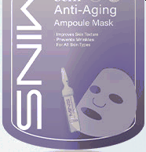
A brightening and spot-lightening ampoule mask can help in inhibiting the production of melanin, promote the metabolism and excretion of melanin, reduce the formation of spots, and brighten skin tone. It can reduce pigmentation, remove dullness and dark spots, and brighten the skin, resulting in glowing and even skin tone.
Suitable skin type: Dull skin, uneven skin tone and other skin issues
ANTI-AGING
EJUVE N 4JILII FF F1-IWE \/ F ULF
Hexapeptide contained in a peptide
/? K
ma sk functions
similar to external application of Botulinum Toxin, which can efficiently penetrate into the skin‘s surface to reduce muscle contractions. It also slows down the appearance of facial expression lines and dry lines. It is a Botulinum Toxin mask that does not require injections and is very suita ble for anti-ag ing.
Suitable skin type: Skin with fine lines, dry lines and other signs of aging.

Slide 4
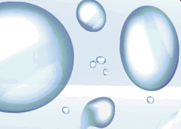
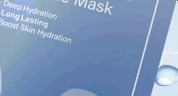
HYDRO BOOSTING
DEEP HYDRATING AMPOULE MASK
AMPOULE MASK
UNIQUE SELLING POINT (USP)
" _{O} " ₀
O O O O
•’•’•’•
Intensive
hydration
0 • 0
Hydro ting skin lose
Skin-friendly and fits well on the skin
BURDEN
ALLERGENIC COMPONENTS
FLUORESCENT AGENTS
ALCOHOL HOItMONES DYES FRAGRANCE HEAVY METALS
Who is suitable for deep hydroting ompoule mask?
Oily sLin type In fact, there are many people with oily sLin who are oily on the outer surf ace but dry on the inner surfac e of their sLins. Con trolling oil w it YouI hydraI ing wilI lead to excess oil production due to exc essi ve control. Thus, hydraI in g is very important.
Dry SLIF1 type— TWO SLIF1 POS IOSS OCF1O OF1d SObUIT1 SOCrOtIOF1, !OWOr ViSlblo
pOrOS, OF1d 0 tlg/t !OellFlg O!tOr WOS/lF1g ISO LOCO.
Usage recommendations:
Deep hydraI in g masL is recommended to use 2—3 times a weeL. Apply a thin layer of loner before use.
One mask, dual benefits

Slide 5
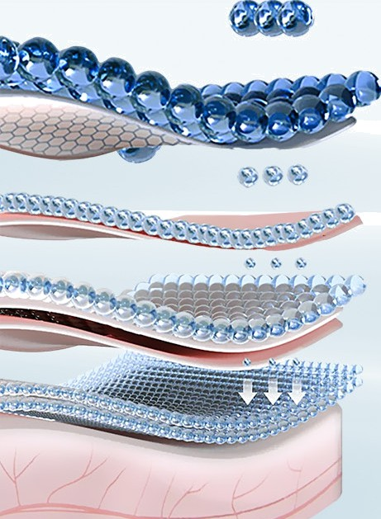
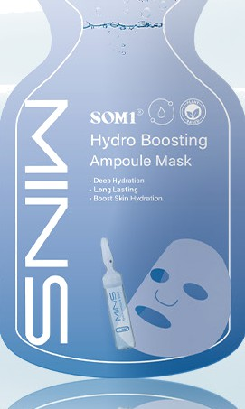
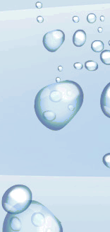
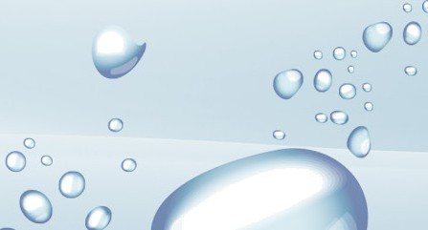
QO.•O’
-
o O‹’
c
HYDROBOOSTING
DEEPHYDRAT|NGAAAPOULEAAASK
Increase in skin moisture
15•/+
Skin surface stabilization
J0•/‹
Rejuvenation
MACROMOLECULE HA
Reduces internal water loss
MICROMOLECULE HA
Hydrotes the surface layer of the skin and transports moisture to the deeper layers of the skin
ESSENTIAL INGREDIENT:
Patent name: [PENTAVITIN]
INCI Names: Saccharide Isomerate
This masL contains PENTAVITIN] , which
provides a deep moisturising effect and the
ability to retain moisture; prolonging the duration of the skin's hydration and moisture retention.
G
o a

Slide 6
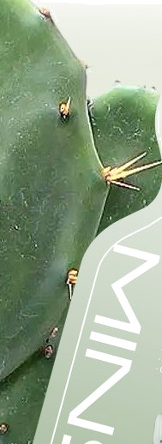
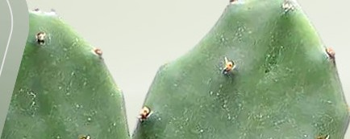
AMPOULE MASK
UNIQUE SELLING POINT (USP)
+O
CALMING
REPAIRING AND CALMING
AMPOULE TASK
Non-steriIe monufocturing
MedicoI repoiring
Soothing and heoKing
Mainly based on water
a nd nutritional ingredients
BURDEN
ALLERGENIC COMPONENTS
FLUORESCENT AGENTS
ALCOHOL HORMONES DYES FRAGRANCE HEAVY METALS
Who is suitable for repairing and calming ompoule mask?
Photon sur germ patients
Individuals who has just completed medical aest Setic project, micro—needl e treatment for acne—prone sLin
Individuals with damage d barriers Individuals with sunburn or redness
Usage recommendations:
A repairing and calming ampoule masL can also be used as a moisturising masL, recommended 64 times a weeL after the application of a loner.
One mask, dual benefifs
TWO IT1OS/ prOtOCtlVO plOCO O! the SllL COF1 bO OppllOd OF1 WOUF1dS SUCH OS CUtS, !OllS, bUrFlS, OtC.

Slide 7
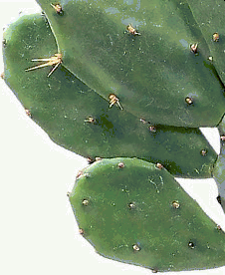
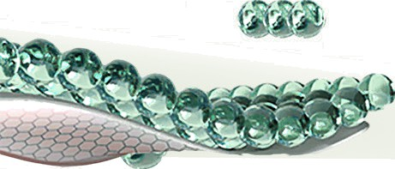
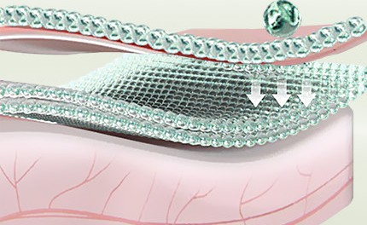
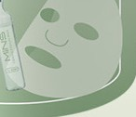
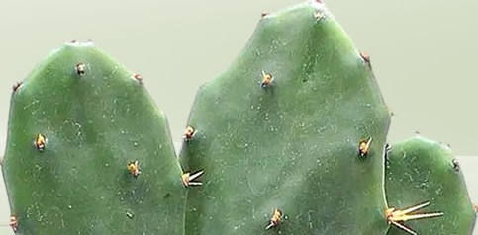
CALMING
REPAIRING AND CALMING AMPOULE MASK
ESSENTIAL INGREDIENT:
Patent nome: [AquaCacteen] INCI Names: Opuntia Ficus—Indica
The organic cactus, Opuntia ficus—indica, is the
source of the extract used in this mask, which is called [AquaCacteen] . It is an active ingredient with highly effective moisturizing and soothing effects; prevents skin sensory nerve cells from releasing stress signals and soothes irritated skin. In addition, it also has a high water-binding compound content; and a
strong moisturizing effect. According to clinical studies, AquaCanteen is highly effective in relieving, calming
and firming.
O•O
Increase in sLin moisture
8 •O
SLin surface stabilization
4O•/‹
Repair sLin barrier
Provides nutritional repairing essence to the sLin surface
Deeply repairs the Leratinocyte barrier

Slide 8
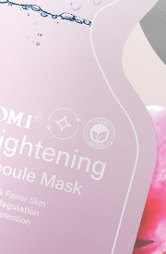
AMPOULE MASK
UNIQUE SELLING POINT (USP)
WHITENING
BRIGHTENING
7' Major active | Whitening | Lightens
whitening | and hydrating | dork spots and
ingredients |  | evens oomplexion
BURDEN
ALLERGENIC COMPONENTS
FLUORESCENT AGENTS
ALCOHOL HORMONES DYES FRAGRANCE HEAVY METALS
3 DONT'S OF WHITENING MASK X
X Do not apply whitening mask after exposing to the sun
X Do not forget to apply sunscreen after using whitening mask
X Do not use whitening mask after doing medical aesthetic treatments
Usage recommendations.
It is best to use a bri ghteni ng masL 3 ti mes a weeL. Apply loner before use, remove after IS minutes and apply a layer of moisturising cream.
One mask, dual benefits
TWO IT1OS/ prOtOCtlVO plOCO O! ISO SllL COF1 bO Opplled OF1 WriStS, LF1OeS, and necL to ensure uni!ormi t/ in the complexion o! all body parts.

Slide 9
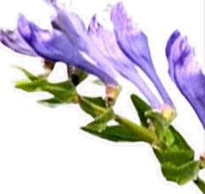
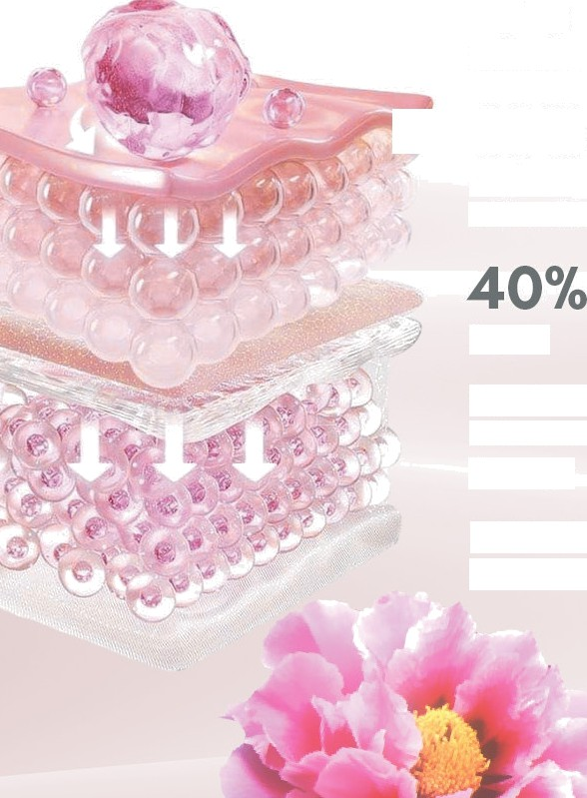
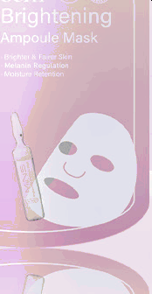
BRIGHTENING
BAMBOO CHARCOAL BRIGHTENING AMPOULE MASK
ESSENTIAL INGREDIENT:
O•O
Increase in sLin moisture
Patent name: [Clair BLANCHE —II]
INCI Names: Arbutin, Acetyl Tyrosine, Saxifraga Sarmentosa Extract, Paeonia Suffruticosa Root Extract, Aminopropyl Ascorbyl Phosphate, Scutellaria Baicalensis Root Extract, Glutathione
8O”O
Brightening and whitening
of the sLin
*
The main ingredient used in this masL is called [Clair
BLANCHE—II] , which is composed of whitening extracts. The primary role production of melanin and reduce
7 highly effective is to prevent the sLin pigmentation,
Repair
thereby achieving the sLin—brightening effect. Clair BLANCHE—II is a collagenase inhibitor that blocks tyrosinase activity, which in turn prevents melanin from being synthesized or deposited. This ingredient is commonly used in whitening sLincare products including masks and lotions, to improve uneven sLin tone, minimize freckles, darL spots, and other skin problems, for radiant and even sLin tone. Furthermore, it also has a repairing effect, which can prevent and repair DNA damage caused by UV radiation.
Repairs cortical inflammation DNA damage
Inhibits the precipitation of melanocytes

Slide 10
UVA/UVB
OUGON
/t 1
KERATINOCYTE
OUGON BOTANPI
Inf smmotbn
Clair BLANCHE-II is a combination of 7 active ingredients for whitening.
soxifrogo sormentoeo Extract
rf go sormentoso Extract
VAP
P@meototbn
KERATINOCYTE
The main function of the first and second ingredients is to help in repairing the DNA of the surface layer of the skin. The fifth ingredient Saxifraga Sarmentosa Extract has
MEDi ATOR(iL-io, HiSTAMiNE Etc) Eu-Me snln/PHEO- MeTonln
MELANIN
the function of removing melanin by
OUGON
penetrating into the skin s dermal layer. Therefore, each of the 7 major effects serves
GLUTATHIONE
a purpose of its own, from the skin s outermost layer to its innermost layer.
oogo-humane
baune
soxifrogo sormentoso Extract
OUGON VAP
MELANOCYTE
ooeo
NAtT
veilsubstance

Slide 11
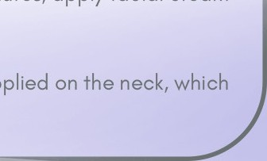
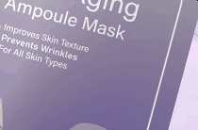
AMPOULE MASK
UNIQUE SELLING POINT (USP)
ANTI-AGING REJUVENATING PEPTIDE 1/v\POULE MASK
Advo need
anti-aging technology
eeduces fine/ dry lines
Slows down aging
Who is suitable for peptide ompoule mask?
It is recommended to start usi ng anti—aging products at the age of 2S. The loss of elastic its with age may cause the appearance of wrinkles OF1d !l FIO llFlOS. Appl/lFlg pOpI ldO OIT1pOUlO IT1OSLS COF1 SIOW dOWF1 the process of sLi n agm g.
ConI ronting the signs of sLin agm g, liLe: fine and dry lines, loss of OlOStlClt/, etC prOblOIT1S. USlF1g pOpt ldO OIT1pOUlO IT1OSLS COF1 /Olp SLiF1 appear younger and dealI Tier, reduce fi ne wrin Lles, increase sLin elasticit y, and improve sLi n texture.
Usage recommendations:
Peptide ampoule masLs are recommended to be used 1—2 times a weeL. Apply loner before usin g the masL. After IS minutes, apply facial cream
and gently massage your face.
One mask, dual benefits
The mesh protective piece of the silL can be applied on the necL, which cOn reduce !i ne lines.
BURDEN
ALLERGENIC COMPONENTS
FLUORESCENT AGENTS
ALCOHOL HORMONES DYES FRAGRANCE HEAVYAAETALS

Slide 12
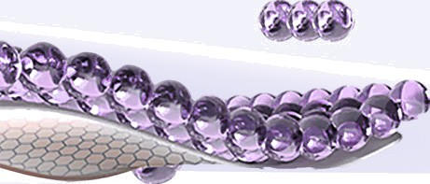
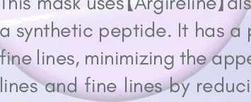
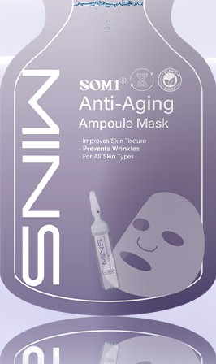
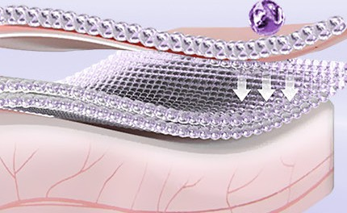
ANTI-AGING
REJUVENATING PEPTIDE AMPOULE MASK
30•/‹
Increase in sLin moisture
O•O
SLin rejuvenation
4O•/‹
Improvement in skin firmness
Penetrates into the surface of the skin
Reduces the surface muscle contraction to achieve the “Botulinum Toxin” effect
ESSENTIAL INGREDIENT:
Patent no me: [Argireline]
INCI No mes: Acetyl Hexa peptide—8
This masL uses [Argireline] ol o Lnown as Hexapeptide-8; a synthetic peptide. If has powerful effect on reduci
e lines, minimizing th ppearonce of facial exprem
lines fine lin reducing muscula r contraction the sLin's surface. The impact on neurotransmitter release
leads to muscle relaxation and reduction in facia I muscle activity, which is very simila r to “Botulinum Toxin”. However, Argireline is different from botulinum toxin, instead, it is a far safer topica I sLincare ingredient thot does not require any injections. In addition, it con help in anti—oxidation and sfimulate sLin collagen production when mix with other anti—aging ingredients to achieve anti—aging benefits.

Slide 13
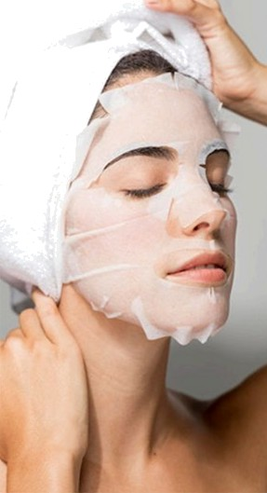
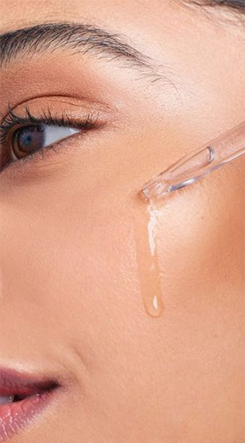
AMPOULE MASKVS ESSENCE
AMPOULE MASK
Applying ampoule masL on the face can gradually allow moisture to penetrate into every pore on the sLin.
Its major function is to improve the absorption of the sLincare essence afler applying ampoule masL.
SiIL masL can improve the penetration of active ingredients into the deeper layer of the sLin
Ampoule masL can deeply nourishes the sLin in a short period of time
ESSENCE
Essence is a highly concentrated sLincare product
Essence is usually lightweight and easily absorbed, suitable for use in daily sLincare routine.
The main function of essence is to provide sLin the nutrients it needs in daily life.
Essence contains small molecules and is easy to absorb

Slide 14
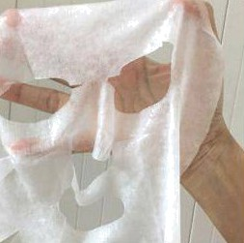
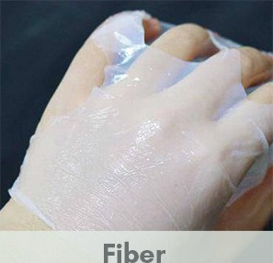
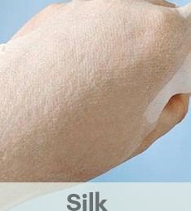
INTRODUCTION TO AMPOULE MASK SHEET TYPES
There are different types of sheet mask materials: Ordinary non-woven fabric, silk, pure cotton, tencel, polyester blended fabric, etc.
The material, fineness and penetration of the facial mask determine the absorption and the
effectiveness. The skin s ability to absorb and the
Non-woven fabric
effect will be significantly affected if the fineness is inadequate or excessively fine but has poor penetration. Therefore, the material we used is silk.
Silk mask is better in adhering closely on the whole face, has good breathability, is suitable for all skin types and strong in retaining water, which holds essence well for skin to be replenished.
Tencel
Pure cotton

Slide 15
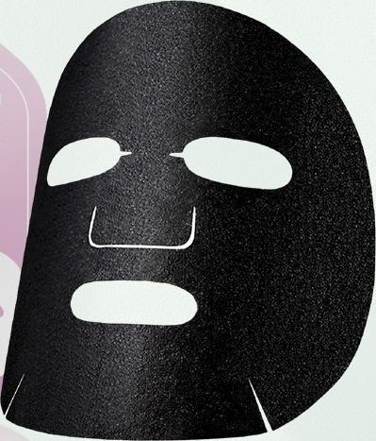
What is on activated carbon mask sheet?
The activated carbon masl‹ sheet contains 12.5% activated carbon. This ultra—clean plant—based nano activated carbon masl‹ uses special plants as raw mater ials and undergoes
BACK SLK
FROM GERMANY
multiple processes including high—temperature activation, carbonization, and nano—treatment to produce a new type of active carbon. The ultra—clean plant—based nano activated carbon mask is black in appearance and its raw materials are nano—sized micro—particles with large specific surface area, rich micropores, and developed porosity.
The ultra—clean plant—based nano activated carbon mask is free of any chemical additives. It not only adheres well to the skin and provides excellent hydration, but also has superior abilities to adsorb dirt, odours, and heavy metals, and exhibits antibacterial effects. Its adsorption rate and capacity are far superior to those of ordinary activated carbon fibre masl‹s.

Slide 16
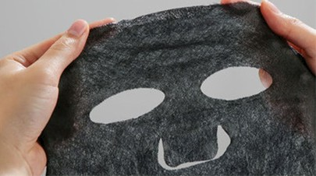
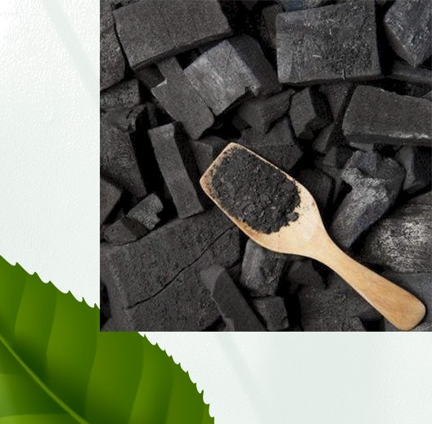
BAMBOO CHARCOAL WHITENING AMPOULE MASK
Due to its excellent absorption capabilities, bla ck activated carbon is a p artic ul arly effective way to eliminate chemica I contaminants and excess oil from pores and sebum. Beyond its ab il ity to cleanse the skin of impurities, it also has antiba cterial and mite—removal effects. As for pore cleansing and purifying, “bl ack mask” provides a more thoroug h cleansing than regul ar masks.
Why do we use block activated carbon facial masks?
In fact, it cleans the dirt in the pores and dead skin by using the
masks' absorption and cleansing abilities. Subsequently, infuse the pore—brightening effect of the 7 maj or active ingred ients into the pores. Beg in the whitening journey of “treating white with bla ck!”

Slide 17
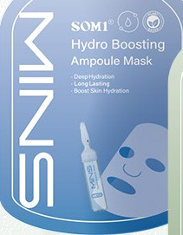
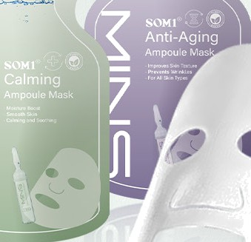
What is silk mask?
Silk mask is the first in the world to a dd complex DNA repo ir a gent in the mask, thereby accel er ating the skin‘s natural healing process, enabling quick restoration of unhealthy and dam ag ed skin and preventing dam ag e from ultroviolet rays and heavy metal substances.
Silk is the lig htest, softest and finest natural fibre in nature. It can closely ad here to the skin‘s grooves, perfectly fits the contours of the fa ce without a ir bubbl es and ensures compl ete covera ge and hydration for every skin area, espe ciol ly on the I ips corner and nasal wing .
Silk mask is lig htweig ht, translucent, soft, and thin. When applied to the fa ce, it is I ess impacted by gravity and can provid e a transparent and invisibl e result. It will not fall off, but also protects the skin from being strained and loosened . In conjunction, there will be no rea bsorption caused by stand ard non—woven masLs.
Oilk is a porous fa bric with high water abs orption and penetration. Its moisturizing ca pa city is 5—10 tim es greater than an ordinary fa cial masks. At the sam e tim e, it has a great water—I ocking function, which can uniformly release the essence and penetrate into the inner Iayer of the skin to repl a ce m oisture and keeps the skin hydra te d for a Iong time;
Food—grad e coll ag en with small m olecul ar weight can directly enter into the dermis and has a high affinity for surround ing tissues, stimul ating normal sLin cell devel opm ent, thereby maintaining your skin smooth, soft and el astic.
WHITE SILK FROM JAPAN

Slide 18
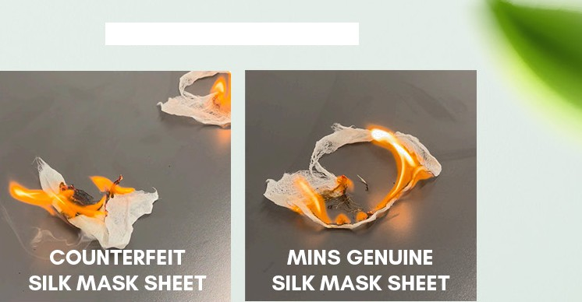
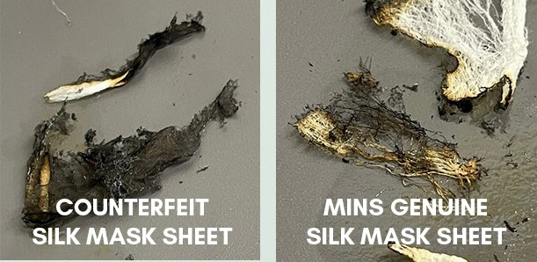
TEARING METHOD
BURNING METHOD
COUNTERFEIT SILK MASK SHEET
MINS GENUINE
SILK MASK SHEET
MINS GENUINE SILK MASK SHEET
Differonee J:
Counterfeit siIL releases a lot of smoke when burned, but genuine siIL does not release much smoLe.
COUNTERFEIT SILK MASK SHEET
MINS genuine silk mask is incredibly elastic and requires only little effort.
Differonoe 2:
There is hard ash residue left after burning of counterfeit silL, while genuine MINS silk turns to powder after being burnt

